Slide 1
AFRICAN FILM & LITERATURE - 2022- WEEK VII, LESSON I
Woman at Point Zero

Slide 2
Overall Thoughts
We focussed on Chapter 2 as we don’t have the time to examine the text in full.
From your reading of Chapter 2, how did you find the text? Did you like it? Dislike it?
Why?
What recurring motifs and symbols do you note? What about the Eyes Firdaus continually sees?
How is dying a means of living for Firdaus?
Chapter 2

Slide 3
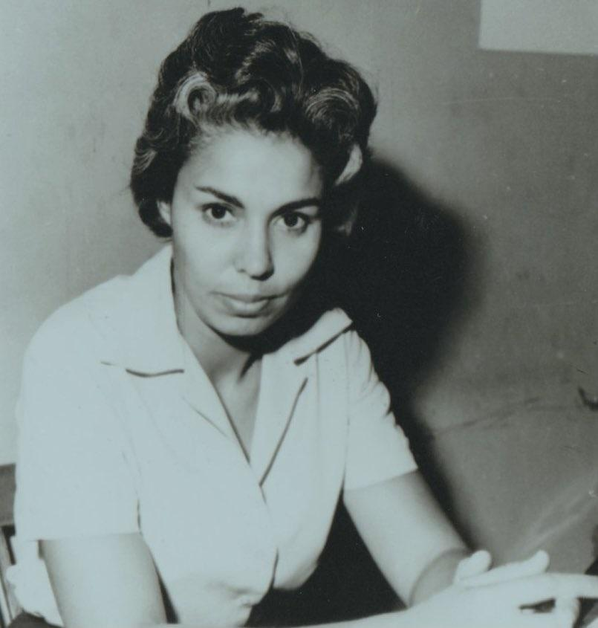
Chapter 2
-What do you make of the style its written in?
-What do you make of its themes? Can you identify them?
- What do you make of its title? What does the title of the novel indicate or suggest? How is related to what you read in Chapter 2?
Nawal El Saadawi

Slide 4
Chapter 2: WPZ
OVERALL THEME:
Woman at Point Zero tackles the issues of gender, oppression, sexual assault, and the misogynistic acts of men which negatively affects the lives of women.

Slide 5
Chapter 2: Warm-Up Group Work (20 minutes)
In groups, referring to SPECIFIC examples in the text, find and discuss 3 quotes to address the following:
Group 1: Thinking broadly, how does Firdaus lose her sense of self? (Think of her repeated discussion of a dim, lost pleasure she can no longer access/Eyes she keep seeing/oppression and repression in her culture)
Group 2: Discuss repeating phrases and/or symbols - how does their meaning change, grow, diminish with each repetition across the Chapter? (Think of the eyes, think about the men rubbing their hands together, talking about Allah) Group 3: What correlations are drawn between woman as a prostitute and woman as a wife and woman as a slave throughout the Chapter?
Group 4: What are the correlations drawn between man as a pimp, man as a husband, and as a master throughout the Chapter?

Slide 6
Chapter 2: WPZ
GENRE & STYLE: p. 9
Nawal El Saadawi’s 1965 novel Woman at Point Zero can be described as a tragedy.
The text can be described as being inspired by true events and real individuals. This is because
Saadawi wrote her novel based on the inspiration of the life and death of a female prisoner she interviewed in Qanatir prison in Egypt.
But why was Saadawi interested in taking this particular route? The reason why Saadawi was as interested in interviewing the female prisoner known as ‘Firdaus’ was because she was conducting research on neurosis which refers to irrational anxiety and or obsession. Considering the life and trauma Firdaus sustains in the text, is her fear, anger, range irrational at all?
Firdaus is the protagonist of the text. Much of the narrative action circles her. Her narrative is multifaceted and discusses and approaches numerous ideas concerning trauma, gender, the law, identity, culture, and power. Her winding life leads her to a prison cell.

Slide 7
Chapter 2: WPZ
FIRDAUS HERSELF: p. 11-13/19-20
Maybe the plight of Firdaus is in some ways guaranteed by the intersection of her life experiences, her gender, her class, and her culture. Firdaus was raised in a poor unnamed farming community which was not stated with her parents.
FIRDAUS’ FAMILY: p. 16-18
But what about her family itself? From Saadawi’s description of her family, Firdaus was the only child and hence had the attention - mostly abuse and unwarranted - from both her parents which resulted in her believing in everything her parents believed in.

Slide 8
Chapter 2: WPZ
FIRDAUS’ FAITH AND CULTURE: p. 10-11/
Firdaus’ father is a firm believer in Islam. This does not prevent him from being very hostile to his wife and daughter. This manifests in severe physical, verbal, and psychological abuse.
It is this hypocrisy of piety that precipitates her ardent and justified distrust and dislike of men and questioning the Islamic culture that her father seems to so much cherish.

Slide 9
Chapter 2: WPZ
FIRDAUS’ SEXUALITY AND AMOROUSNESS: p. 12-13/20-22/28-32/33-34/44-47
Firdaus ends up falling in love with a young boy Mohammadain with whom she experiences her first clitoral stimulation with. In this very intimate, youthful, and private space, Friday is given a glimpse at a different kind of masculinity.
This leads to yet another type of masculinity which is in many ways the opposite. After her parents die, Firdaus is taken in by her uncle and his wife who live in Cairo. In this space, she is sexually assaulted by him. This represents numerous types of ‘cutting away’, separations of self from self, that Firdaus undergoes.
On the one hand, she is cut off from any sense of mutual pleasure, safety, and equal participation in her own sexuality that she got a glimpse of with Mohammadain. On the other hand, sexuality as experienced with her uncle is exploitative and non-consensual.
In the most direct sense, hoever, Friday is literally and figuratively cut off from her own pleasure and sexuality due to the genital mutilation she is subjected to.

Slide 10
Chapter 2: WPZ
FIRDAUS & EDUCATION: p. 24-28/36-39
Education as a means of power and identity is a recurring theme in the text.
After Firdaus graduates from school, her aunt arranges for her to be married to a man she has never met. As a result, she runs away from home, wandering the streets until she meets the owner of a coffee shop, Bayoumi who takes her in and gives her shelter.

Slide 11
Chapter 2: WPZ
FIRDAUS & THE ‘NICE GUY’ TRAP: p. 49-53/96-97
Initially, Firdaus feels she has found a measure of escape and safety in Bayoumi. However, when she expresses that she wants to get a job, Bayoumi gets angry, beats her up and brings his friends over to assault her. This part of the book shows how insecurity affects men in the sense that Fridaus wanting to be an independent woman disturbs Bayoumi to such a degree that he seeks to punish Firdaus for it in the most brutal of ways.
Here, female independence is linked or associated with something punitive, that requires punishment.
Bayoumi is also representative of the topic of patriarchy and gender oppression in the sense that Fridaus is not allowed to be independent and to always rely on Bayoumi for basic items.

Slide 12
Chapter 2: WPZ
FIRDAUS AND THE STRUGGLE OF INDEPENDENCE: p. 58/74/81-83/93-94/97-100/104-106
With the help of a neighbor, Fridaus manages to escape.
On the one hand, her constant escapes show how courageous she is in situations that many would view as inescapable. She is, in many ways, the embodiment of the concept and practice of resistance to oppression. On the other hand, her constant need to escape such situations suggests that the actual laws, morals, culture she is in is designed to enshrine, encode, and enforce these very same situations in the first place.

Slide 13
Chapter 2: WPZ
Despite this, Firdaus constantly refuses to be under the influence and authority of men as she constantly tries to run away. But the underlying question is: can Firdaus escape the underlying ideas that govern her immediate surroundings? What are these ideas? Saadawi makes it clear that most of these ideas stem from misogyny harbored in men; that is, the internalized hate against women pushes them to constantly oppress and harass women.
In the case of Fridaus, the one time she decides to stand up for herself, she gets arrested and sentenced to hanging. This is a clear depiction of what might happen when women decide to stand up for themselves.

